Slide 1
The impact of integrating artificial intelligence and Building information modeling (BIM) systems on the development of construction methodologies
Week 7 Ed Elowson

Slide 2
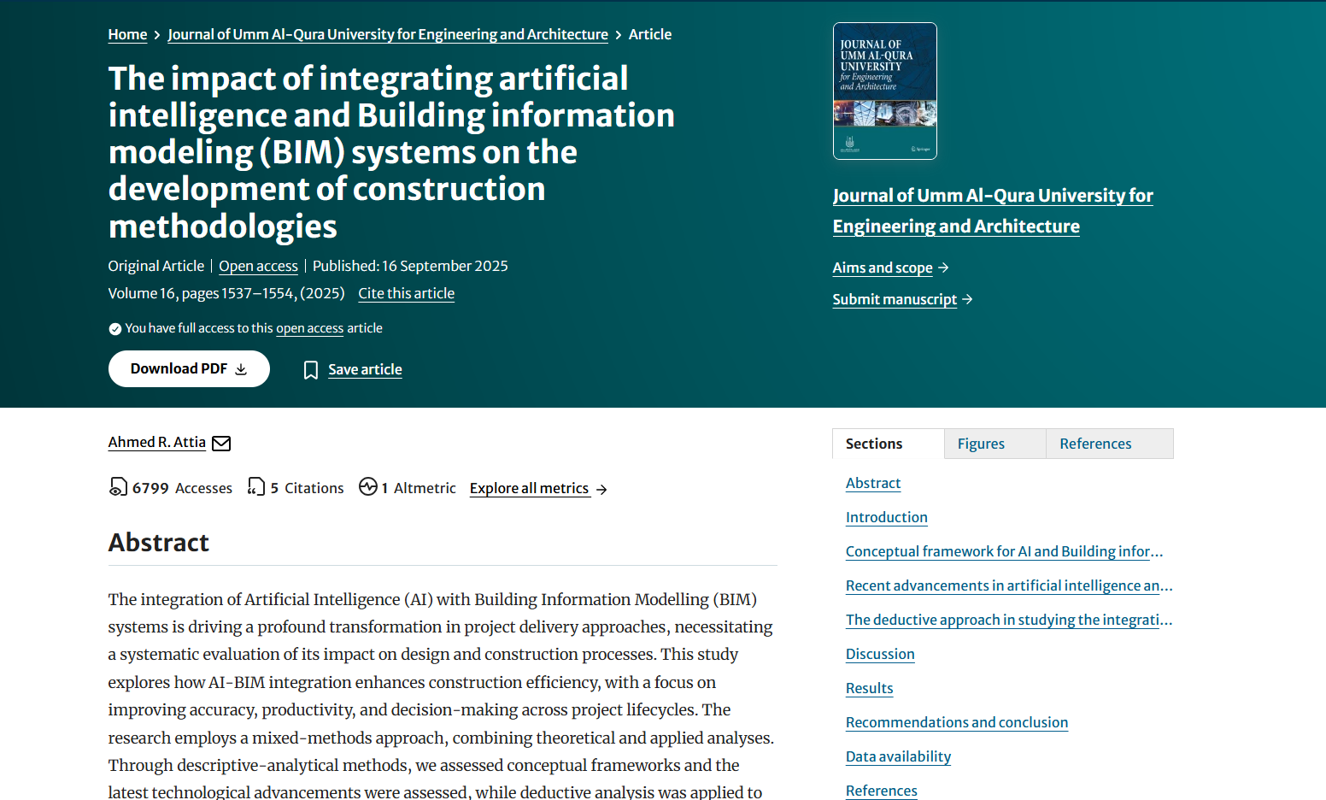
Screenshot

Slide 3

Link To The Source
https://link.springer.com/article/10.1007/s43995-025-00193-2

Slide 4
Main Findings
1) 🧾 Main Findings and Arguments
Core Findings:
AI + BIM enhances efficiency and productivity
Automates repetitive design and modeling tasks
Quantitative results: ~32% reduction in design time, ~45% reduction in manual effort, ~28% increase in productivity
AI improves accuracy and reduces errors
Detects clashes and coordination issues automatically across structural, mechanical, and electrical systems
Leads to fewer costly design changes later
AI supports informed decision-making
Evaluates energy efficiency, structural performance, and design alternatives
Allows project teams to make data-driven decisions earlier in the design and planning phases
Shift in construction methodologies
AI + BIM is not just a tool upgrade; it enables predictive, automated, and collaborative project workflows
Facilitates a move from reactive problem-solving to proactive planning
Main Argument:
Integrating AI with BIM transforms construction from manual, error-prone processes into data-driven, intelligent workflows that optimize both design and execution.

Slide 5
Broader Implications for Society
2) 🌍 Broader Implications for Society
More sustainable and efficient buildings
AI can evaluate energy performance and suggest improvements in design stages
Reduces material waste and improves resource allocation
Workforce transformation
Roles in construction and engineering shift toward digital and AI literacy
Less manual drafting, more focus on data analysis, AI supervision, and strategic decision-making
Enhanced safety and quality
Clash detection and predictive insights reduce onsite mistakes, lowering accident risk and improving overall project quality
Acceleration of smart infrastructure
Buildings become digitally intelligent from the design phase, aligning with the rise of smart cities and sustainable urban development

Slide 6
Relevance and Potential Influence on the Construction Industry
3) 🏗️ Relevance and Potential Influence on the Construction Industry
Redefining project workflows
AI + BIM enables automation of modeling, scheduling, and coordination, fundamentally changing how construction projects are executed
Higher efficiency and cost savings
Reduces design time, prevents costly errors, and improves resource allocation
Competitive advantage
Firms adopting AI + BIM can deliver higher-quality, faster, and more sustainable projects
Integration of digital ecosystems
Encourages convergence of design (architects, engineers) and operations (contractors, project managers)
Paves the way for continuous feedback loops from design to operation
Long-term industry transformation
AI-driven BIM workflows may become the standard in mid-to-large scale construction projects
Promotes more predictive, collaborative, and intelligent construction management

